Slide 1
Ambidextrous centralised-deconcentrated regulation: A solution to problems with professional regulation for doctors & nurses in Kenya & Uganda?
Gerry Mcgivern¹, Frank Wafula², Gloria SeruwagiI³, Tina Kiefer¹, Catherine Nakkidde³, Anita Museiga², Dosila Ogira², Mike Gill⁴ & Mike English⁴
OBHC Conference, Birmingham, 13-15th Sept 2022
¹Warwick Business School (UK), ²Strathmore Business School (Kenya), ³Makerere University (Uganda), ⁴University Of Oxford (uk)

Slide 2
Regulation in health Systems in LMICs
Regulation is often poorly implemented, weakly enforced & ineffective in health systems in low- & middle-income countries (LMICs)
Regulators lack financial resources, staff numbers & expertise, corruption & professional capture are common
Malpractice & negligence are consequently widespread
Little research on professional regulation in LMICs

Slide 3
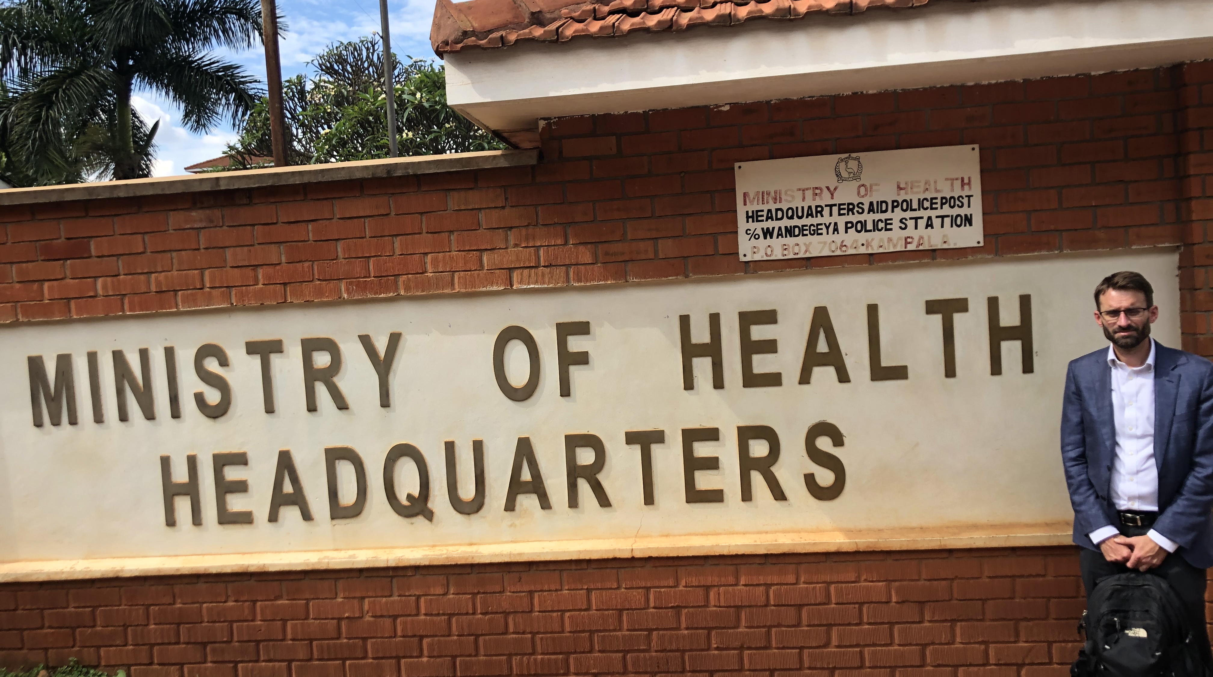
Researching regulation of drs & nurses/midwives in Kenya & Uganda
UK Medical Research Council Health Systems Initiative-funded project examining professional regulation for doctors & nurses/midwives in Kenya & Uganda (2019-21)
RQ: How do regulatory stakeholders & health professionals experience health professional regulation in LMICs & how might it be improved?
29 National-level stakeholder interviews (12 Kenya; 17 Uganda, 2019-20)
47 interviews with ‘frontline’ drs & nurses/midwives in 2 Ugandan districts (28) & 2 Kenya Counties (19) (2020)
Online survey of drs & nurses/midwives in Kenya & Uganda (3466 responses, 2021)
4 focus group discussions (2021; 12 Kenyan & 21 Uganda participants)
Thematic coding of data

Slide 4
FINDINGS: Regulatory PROBLEMS
Regulators lack resources, more focused on collecting fees than regulating standards: “remote” & “out of touch” with professionals; Survey: 33% agreed ‘I had sufficient contact with staff from my regulator in the last year’
Survey: 71% (strongly) agreed ‘The regulations that govern my profession are appropriate’ but many interviewees could not articulate what regulation are
Regulations “don’t exist in practice”; “Regulators are lenient. There are no punitive measures. That encourages impunity… [not] deter others from being negligent.”
Survey: 51% (strongly) agreed ‘I have witnessed medical or nursing malpractice where I work’; 7% of those said they ‘reported the concerning colleague to their professional regulator’
Limited social accountability: “The regulator only comes if the family complains so much it appears in the media.”; “80% of our people reside in the rural areas, ignorant of their rights”
Inadequate regulation of declining standards of professional training: “It’s a mess. The quality of our doctors is down, they’re not properly trained. I don’t see any regulatory mechanism for who gets into medical school, who qualifies, there’s no unified standards.”

Slide 5
IMPROVING REGULATION
Developing on-line (re)licensing : “The benefits of online now, we don’t have to travel, it’s very easy. Once I’ve done my CPD, I renew my license, click and pay with M-Pesa and you print your certificate. Before we used to travel to Nairobi. That would take a week. Now it’s a few minutes. (Doctor, Kenyan county).
Regulatory decentralization: “It used to be difficult. Once registration was brought to this hospital, there is now no problem. When there are problems, they [regional office] forward them to the Council, then they come, see problems and get solutions.” (Nurse, one Ugandan district)
Systemic regulatory collaboration needed across healthcare professions and organizations:
“A mother in a health centre starts to bleed but it takes too long to get the ambulance, so by the time the mother reaches the referral hospital they’ve bled too much, the doctors struggle, lose the mother. If you want to blame people, on face value, it looks like the doctor’s or nurse’s malpractice or professional negligence but there is always an institutional gap.”
Kenya Health Professionals Oversight Authority (KHPOA, est. 2017); "The idea behind the KHPOA is good but lots of work still needs to be done. What is happening is happening in a vacuum. It needs much more support.”
Administrative efficiencies freeing regulators to regulate? “Time & effort are focused on registration, licensing & collecting fees, which is a huge job that someone else could do, so regulators are free to regulate the profession. Currently enforcement is geared towards people who have not paid licences, instead of practice, ethics & conduct.” (Ministry of Health official, Uganda)

Slide 6
SOLUTIONS?
‘Ambidextrous organizations’: simultaneously ‘exploiting’ (efficiency/standardization) & ‘exploring’ (innovation/adaptation) (O’Reilly & Tushman, 2004; Raisch & Birkinshaw, 2008)
‘Health systems are most efficient when they combine centralization & decentralization; centralization of functions that benefit from economies of scale… decentralization of functions that require ‘close to ground’ decision-making.’ (Abimbola et al. 2019: 612)
‘Decentralization’ (full delegation of responsibility to local level) vs ‘deconcentration’ (local offices) (Abimbola et al. 2019)
Politics in centralisation-decentralisation (Barasa et al 2017; Abimbola et al 2019)

Slide 7
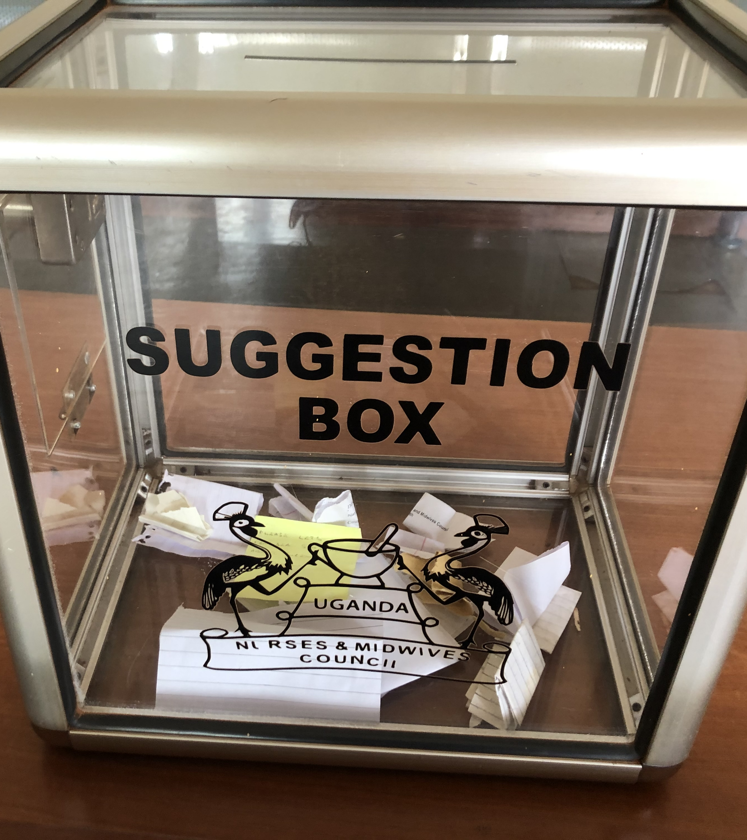
‘AMBIDEXROUS CENTRALISED-CONCONCENTRATED REGULATION’
Deconcentration
Local regulatory offices (district/county level) more able to detect & address ‘frontline’ problems (e.g. Ugandan nursing regulator district office)
Local regulatory offices could share common good practices, learning & solutions & highlight common problems needing to be addressed at national level
Accompanied quality & safety improvement initiatives to foster professional ownership & learning
Centralisation
Online (re)licencing administration across regulators making efficiency savings releasing resources for deconcentrated regulatory monitoring
Regulatory oversight (e.g. KHPOA) tackling systemic problems (which professional regulators cannot address individually)
Requires resources & technically & politically skilled leadership

